Slide 1


Tribe Talk
Rider Choices
Sunday October 25th, 2020 at 8:00 pm Eastern

Slide 2
Purpose
The Tribe is a group of like-minded people who have more in common than they have differences.
Tribe Talk is a dialog with Coaches to enhance communications and help develop an improvement culture, sharing experiences and ideas for the betterment of the tribe.
This is an independent event, not sponsored by any organization regardless of who participates. The one simple motive is improvement of the Tribe and our ability create responsible – thinking, motorcyclist with good judgment.

Slide 3


Tribe Talk Etiquette
Mute Microphone when not speaking
Please use Raise Hand Icon, located at bottom of the participants window.
You can also text questions in FaceBook or Zoom for moderators to ask.
Please consider adding your name and location as your screen name.
Consider and share context and jurisdictional constraints in responses.
Lurkers are welcome!
Please re-enter the talk if there are technical difficulties.

Slide 4
Tribe Talk Topics – October 25th, 2020
Comparison of Instructor Candidate Selection in the United States
Tribe Talk Weekly Poll 25 October 2020
vRETS Tuesday 27 October 2020, 8:00 pm Eastern

Slide 5
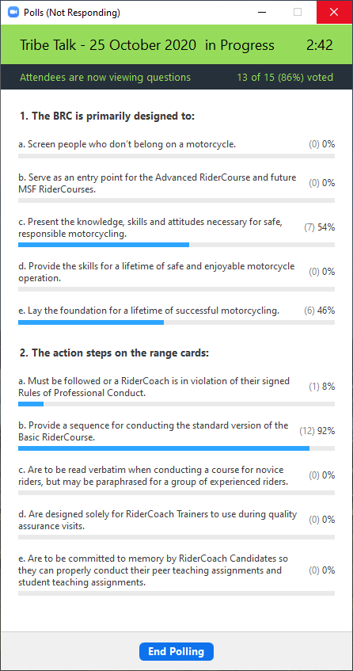
Tribe Talk Poll Questions

Slide 6
How to build the Tribe
Invite others to Participate!
Share Ideas for future topics.
Volunteer to host/present.
Help develop the platform by asking other RiderCoaches to participate.
Be motivated to Mentor or be Mentored
Leave your feedback and future Ideas at:
https://www.riderchoices.com Select RiderCoach Info and Tribe Talks

Slide 7
Tribe Talk Wrap up – 25 October 2020
Comparison of Instructor Candidate Selection in the United States
vRETS Tuesday 27 October 2020, 8:00 pm Eastern
Next Tribe Talk - Sunday November 29th, 2020 – 8:00-9:00 pm Eastern
Tribe Talk Happy Hour – continues every Wednesday 7:00-9:00 pm Eastern

