Slide 1
Less is More
Coaching with fewer words

Slide 2
Less is More
What’s our methodology for teaching courses?

Slide 3
Less is More
What’s our methodology for teaching courses?
  To provide an accelerated Adult/learner centric course that’s high challenge and low threat (good stress). Page 30 RCG.

Slide 4
Less is More
What’s our methodology for teaching courses?
  To provide an accelerated Adult/learner centric course that’s high challenge and low threat (good stress). Page 30 RCG.
What’s the student’s motivation to attend our classes?

Slide 5
Less is More
What’s our methodology for teaching courses?
  To provide an accelerated Adult/learner centric course that’s high challenge and low threat (good stress). Page 30 RCG.
What’s the student’s motivation to attend our classes?

Slide 6
Less is More
What’s our methodology for teaching courses?
  To provide an accelerated Adult/learner centric course that’s high challenge and low threat (good stress). Page 30 RCG.
What’s the student’s motivation to attend our classes?
  To learn how to ride safely, get a license waiver, money on the line.

Slide 7
Less is More
What’s our methodology for teaching courses?
  To provide an accelerated Adult/learner centric course that’s high challenge and low threat (good stress). Page 30 RCG.
What’s the student’s motivation to attend our classes?
  To learn how to ride safely, get a license waiver, money on the line.
Key point is the students are here voluntarily, they are not obligated in any way to attend one of our classes or learn anything from the courses. It’s up to them to make that decision, how you facilitate/coach the course can make the difference in their success.

Slide 8
Less is More
  How do we present a range exercise? Ideally
    Read Cards – verbatim (talk to students)
    Execute Demo, while presenting eval points during demo (talk to students)
    Show static demo – if required. Keep brief short instruction (talk to students)
    Execute static practice – if required. Keep it brief. (talk to students)
    Coach students, keep it brief and to point (Timely tip) (talk to students)
    Reflect/debrief (talk to students, let students self-assess)

Slide 9
Less is More
  How do we present a range exercise? Reality
    Read Cards – verbatim (talk to students)
    Rehash cards in simplified manner, sometimes multiple times. (talk to students)
    Execute Demo, while presenting eval points during demo (talk to students)
    Sometimes the demo rider will even come over and give directions to students. (talk to students)
    Show static demo – if required, demo becomes a full set of instructions (talk to students)
    Execute static practice – if required, practice becomes full set of instructions (talk to students)

Slide 10
Less is More
  How do we present a range exercise? Reality
    Read Cards – verbatim (talk to students)
    Rehash cards in simplified manner, sometimes multiple times. (talk to students)
    Execute Demo, while presenting eval points during demo (talk to students)
    Sometimes the demo rider will even come over and give directions to students. (talk to students)
    Show static demo – if required, demo becomes a full set of instructions (talk to students)
    Execute static practice – if required, practice becomes full set of instructions (talk to students)
  What happens to students by this point?
  Keep in mind they haven’t ridden yet.

Slide 11
Less is More
  How do we present a range exercise? Reality
    Read Cards – verbatim (talk to students)
    Rehash cards in simplified manner, sometimes multiple times. (talk to students)
    Execute Demo, while presenting eval points during demo (talk to students)
    Sometimes the demo rider will even come over and give directions to students. (talk to students)
    Show static demo – if required, demo becomes a full set of instructions (talk to students)
    Execute static practice – if required, practice becomes full set of instructions (talk to students)
  What happens to students by this point?
  Keep in mind they haven’t ridden yet.
  (blank stares into space, loss of interest, completely forgot what was asked to do, checked out of process)

Slide 12
Less is More
  How do we present a range exercise? Reality
    Read Cards – verbatim (talk to students)
    Rehash cards in simplified manner, sometimes multiple times. (talk to students)
    Execute Demo, while presenting eval points during demo (talk to students)
    Sometimes the demo rider will even come over and give directions to students. (talk to students)
    Show static demo – if required, demo becomes a full set of instructions (talk to students)
    Execute static practice – if required, practice becomes full set of instructions (talk to students)
  What happens to students by this point?
  (blank stares into space, loss of interest, completely forgot what was asked to do, checked out of process)
    Execute exercise – (potential of herding cats, because you confused or lost the students interest)
    Coach students – if required, student coaching becomes a lecture (talk to students)
    Reflect/debrief with thought provoking questions (talk to students, reflection becomes story time)

Slide 13
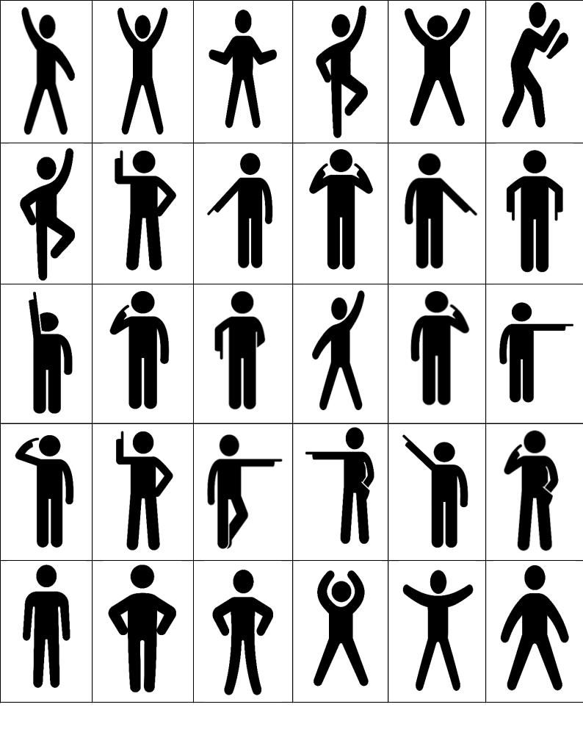
Less is More
    Directed Images

Slide 14
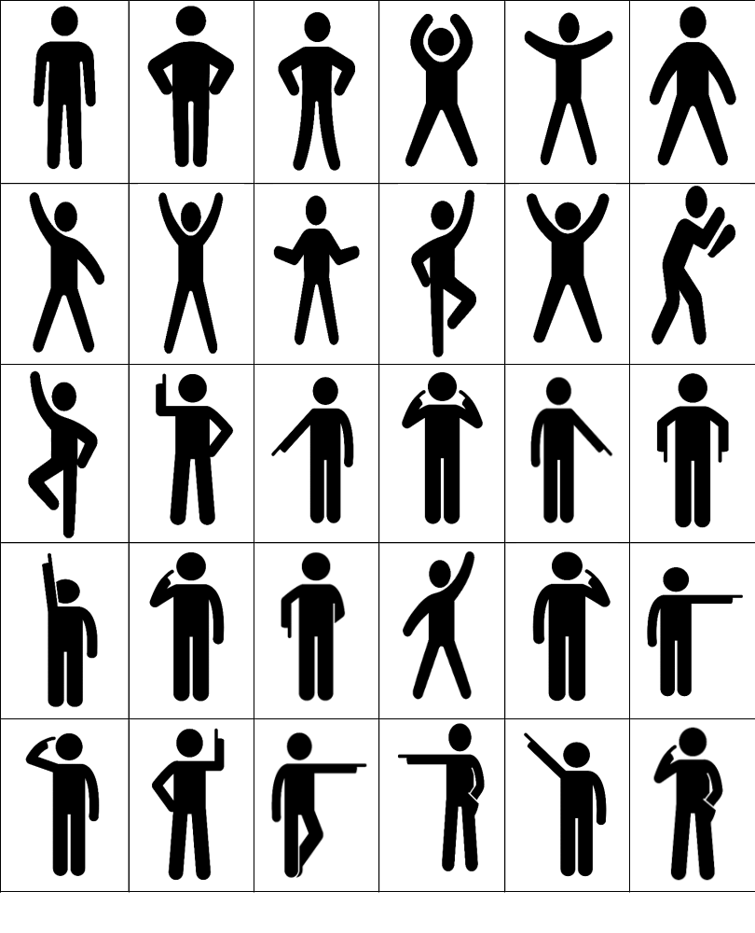
Less is More
    Undirected Images

Slide 15
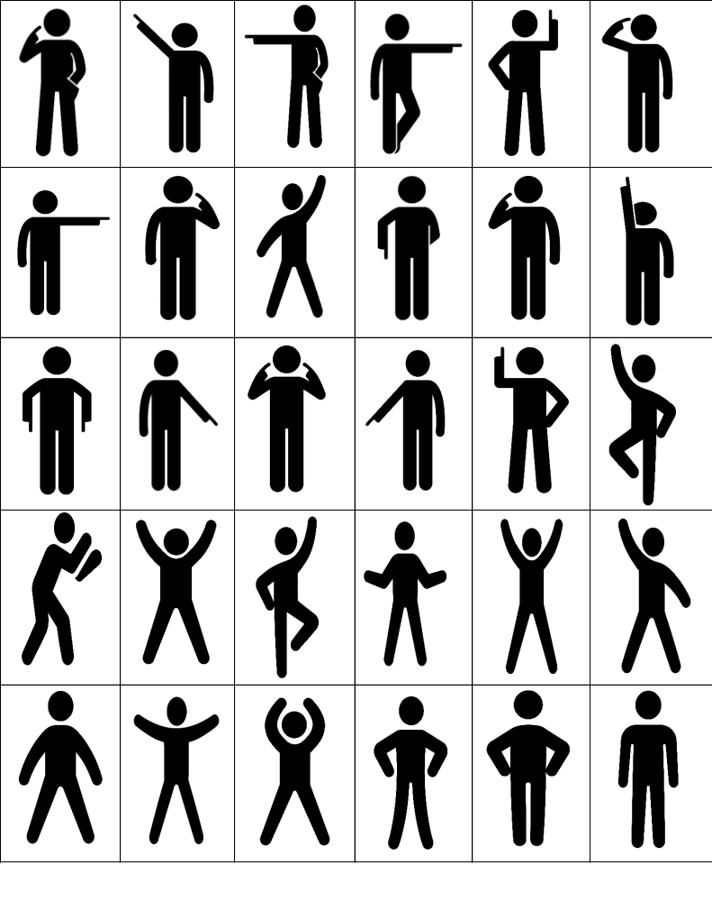
Less is More
    Visual only Images

